Slide 1
The Myths and Reality of Augmented Reality
Luke Parlin, Jarek Francik Kingston University 2020

Slide 2

Quick demographics check:
How much experience do you have using AR?
Are you interested in AR outside of the context of DSP?

Slide 3

My relationship to AR
Casual AR gamer
Casual AR programmer
I am not, by any means, an AR expert
I am a massive AR sceptic

Slide 4
What is Augmented Reality?
That thing where you look through your phone…

Slide 5
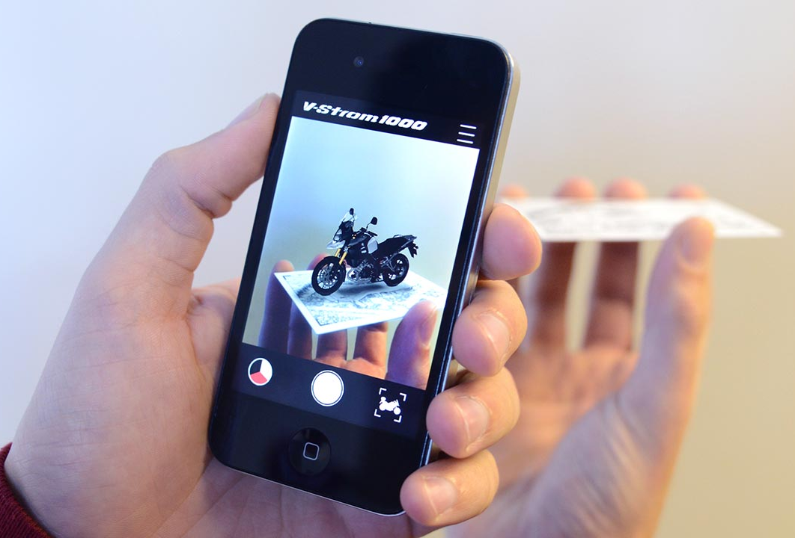
Let’s poll the room:
What do YOU think AR is?
When is AR useful? (is AR ever useful?)
Is AR already used in everyday life?

Slide 6
How is Augmented Reality defined?
“
Augmented reality (AR) is an interactive experience of a real-world environment where the objects that reside in the real world are enhanced by computer-generated perceptual information, sometimes across multiple sensory modalities, including visual, auditory, haptic, somatosensory and olfactory.
”
– Wikipedia

Slide 7


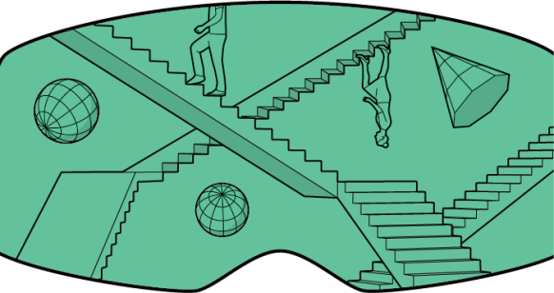
AR in the context of other technologies
Augmented Reality
Mixed Reality
Virtual Reality

Slide 8

The “Reality-Virtuality Continuum”

Slide 9

We need to broaden our definition of AR
AR can go beyond visualization
Holographic displays don’t (really) exist yet
If pigeonholed, AR becomes a simple gimmick

Slide 10
The History of Augmented Reality
AR has been around longer than we have, sort of

Slide 11

First envisioning of Augmented Reality
1901, The Master Key, L. Frank Baum
A “Demon of Electricity” gives a young boy magic glasses which display information about each person he meets

Slide 12
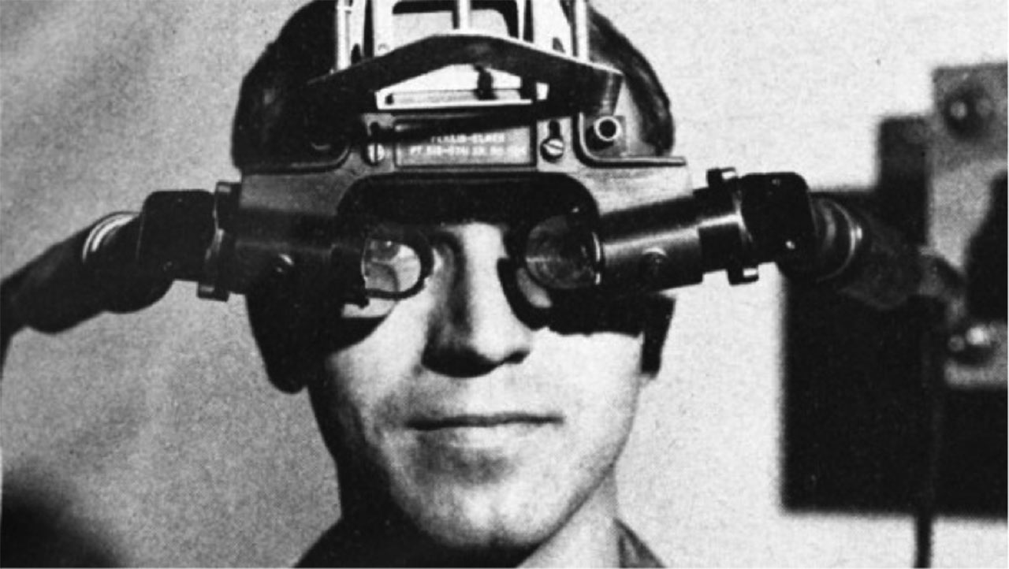
The first Head-Mounted Display
1968, The “Sword of Damocles”, Ivan Sutherland
Stereoscopic, head tracking, gaze tracking
Suspended from the ceiling

Slide 13
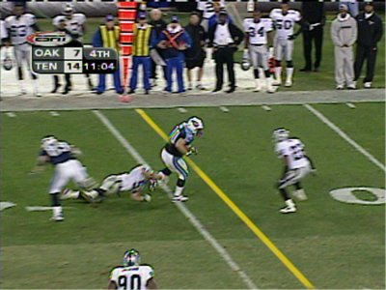
Augmented Reality on live television
1998, 1st & Ten, Princeton Video Image
Used to overlay the “first down line” during American Football games
Also commonly used during weather forecasts

Slide 14
The Current State of Augmented Reality
Does anybody still play Pokémon Go though?

Slide 15
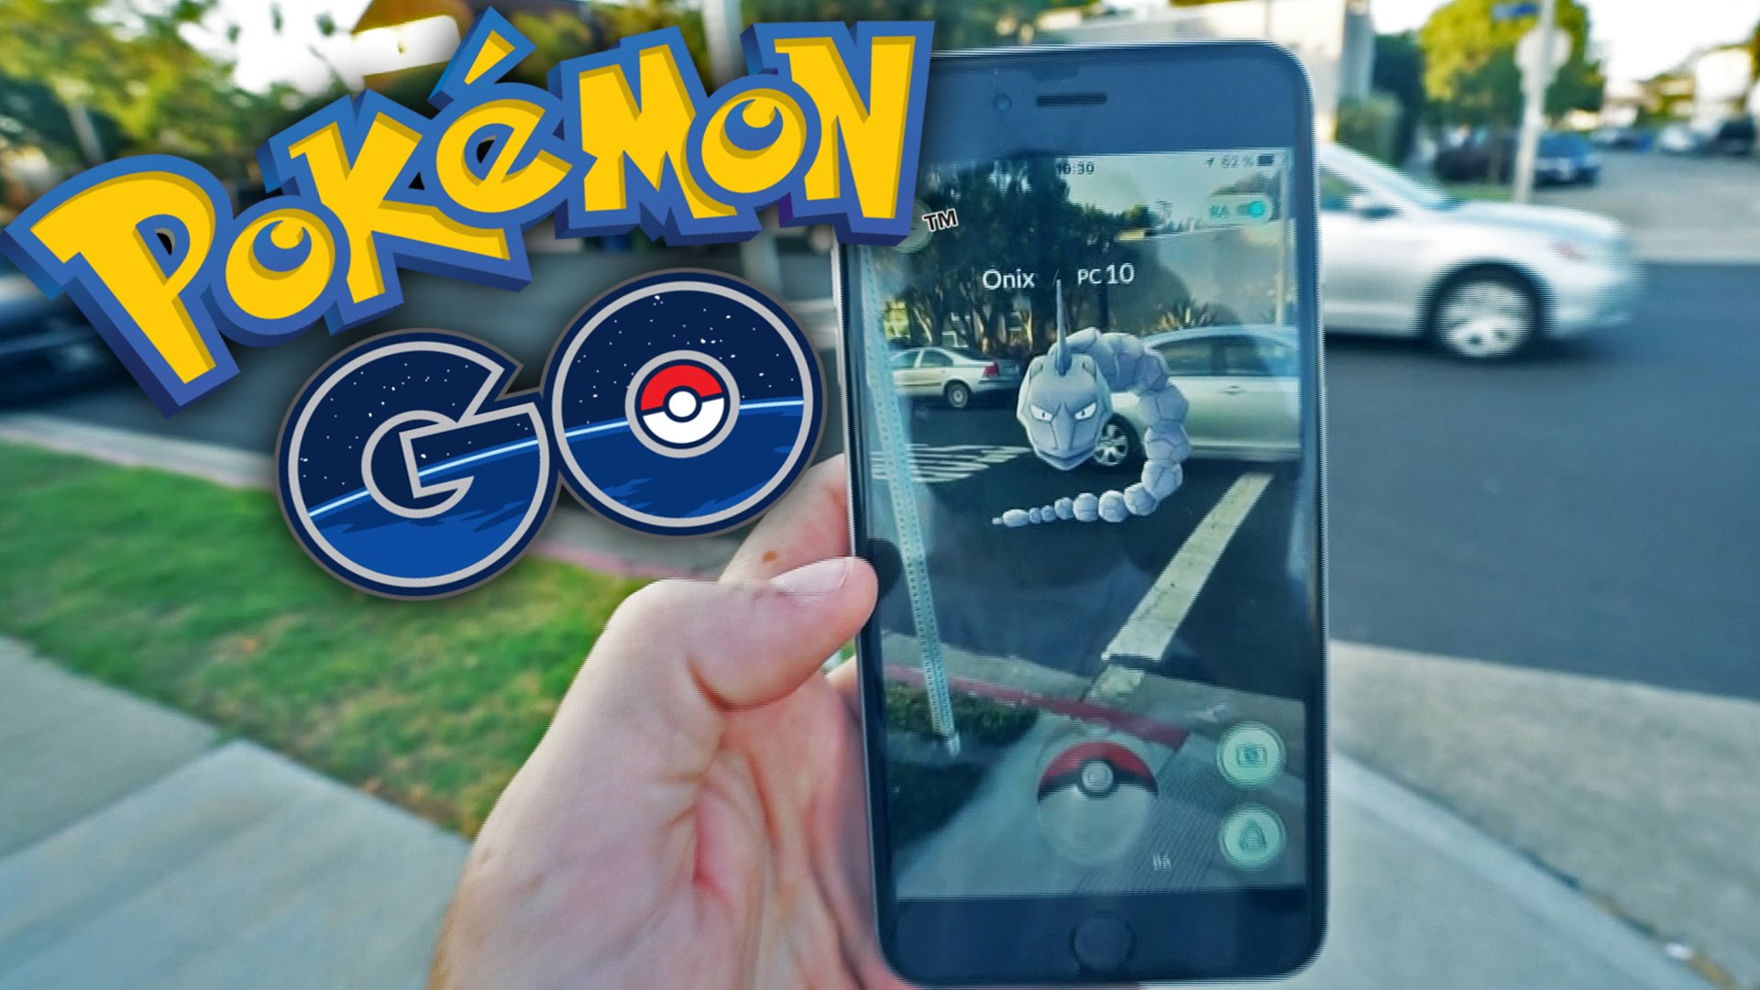
Augmented Reality’s killer app?
Pokémon Go is the most successful AR app to date
Over 750million downloads, and over $1.5billion in revenue
But is it really AR?

Slide 16
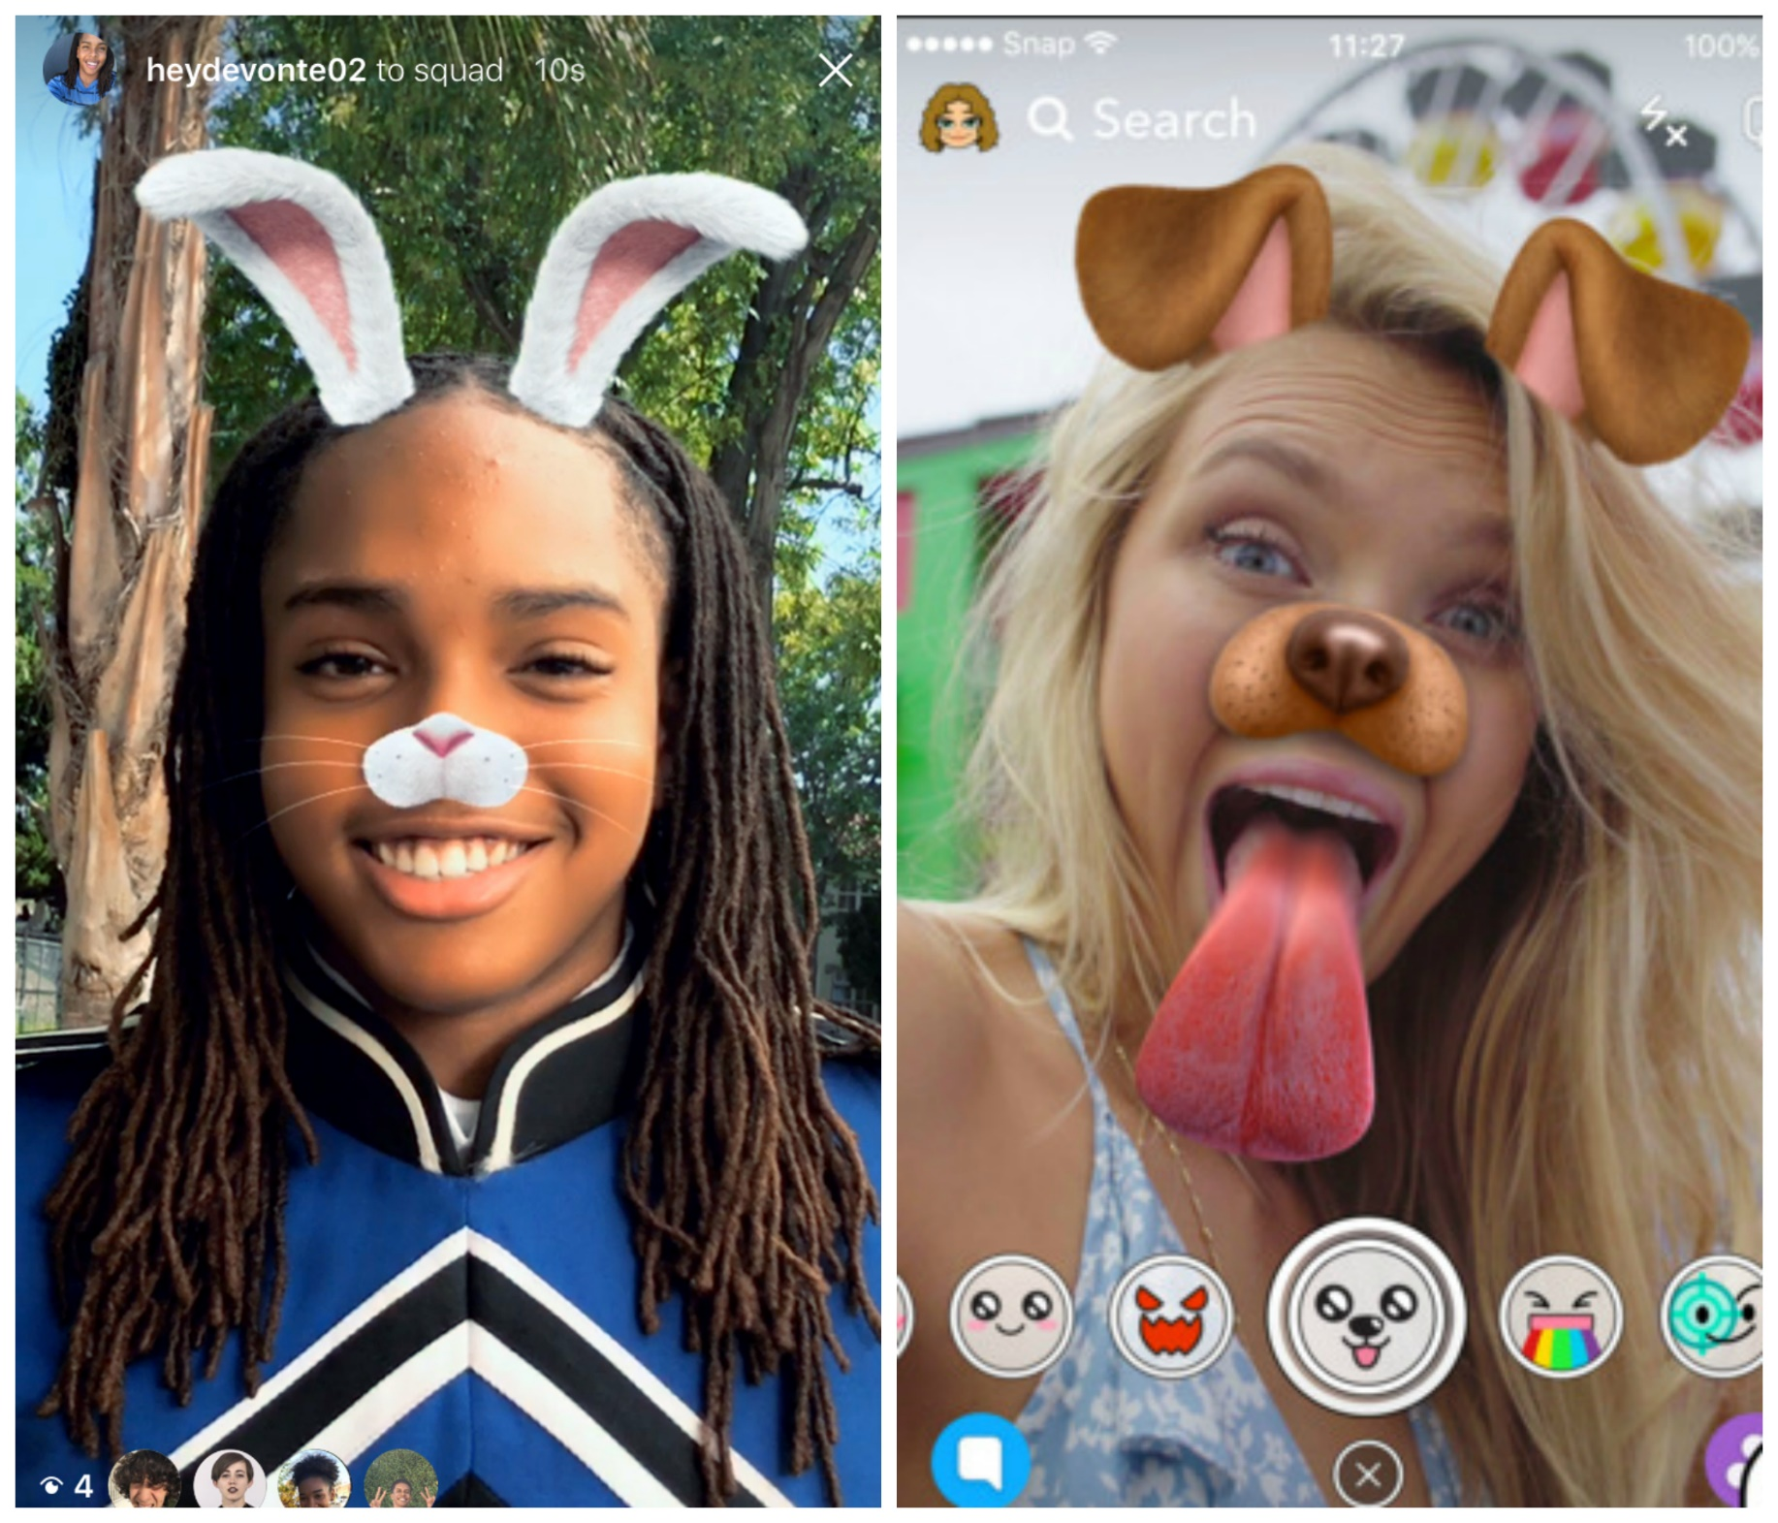
Or maybe this is AR’s killer app?
Snapchat introduced “Geofilters” and the “Lens” features in 2014 and 2015
Snapchat released Spectacles in 2016, allowing users to record images and video phone-free

Slide 17
Let’s poll the room:
Which is currently the #1 AR Mobile Game?
Which is currently the #1 AR Mobile App?

Slide 18
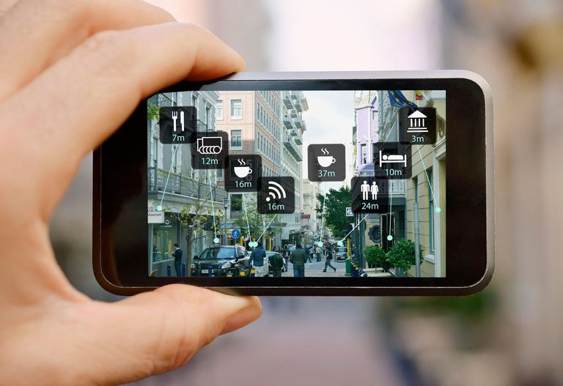
Mobile AR UX is terrible
Do people want to play games like this?
Is it even worth viewing 3D models like this?
Can you think of any scenario where this is better than, say, Google Maps?

Slide 19
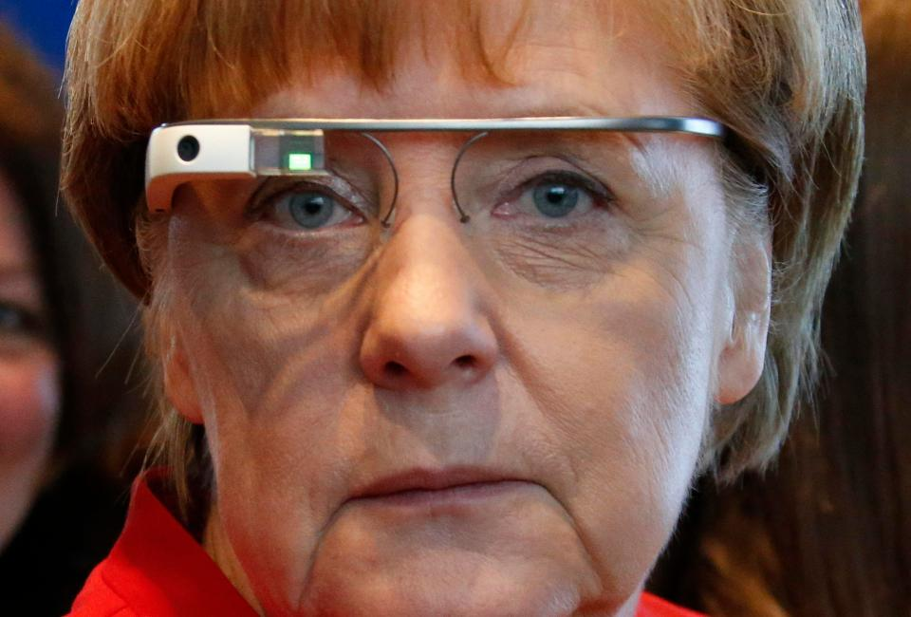
Dedicated AR HMD’s are coming
Google Glass – announced in 2011, released in 2013, cancelled in 2015, and re-announced in 2017
These devices face a tremendous uphill battle

Slide 20
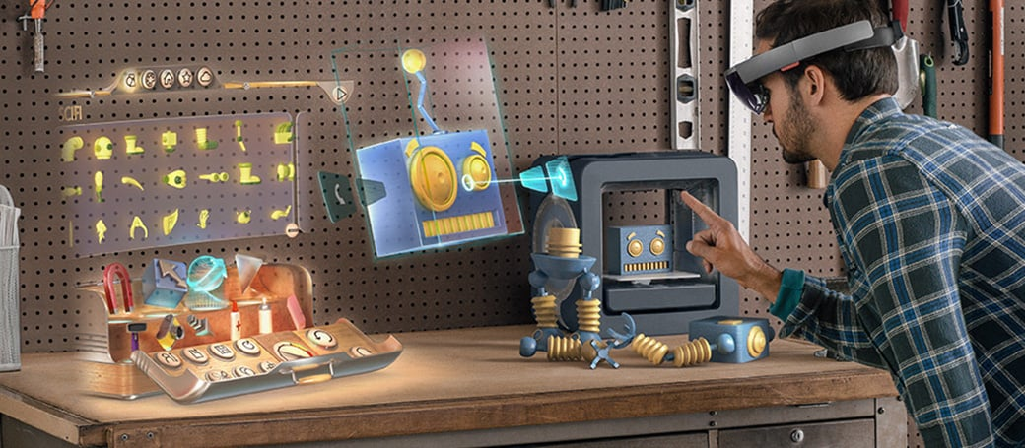
Mixed Reality, the HoloLens

Slide 21
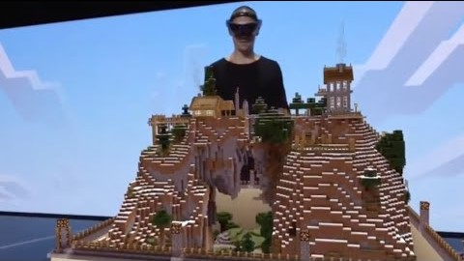
Mixed Reality, the HoloLens

Slide 22
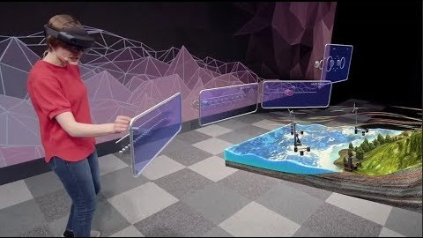
Mixed Reality, the HoloLens

Slide 23
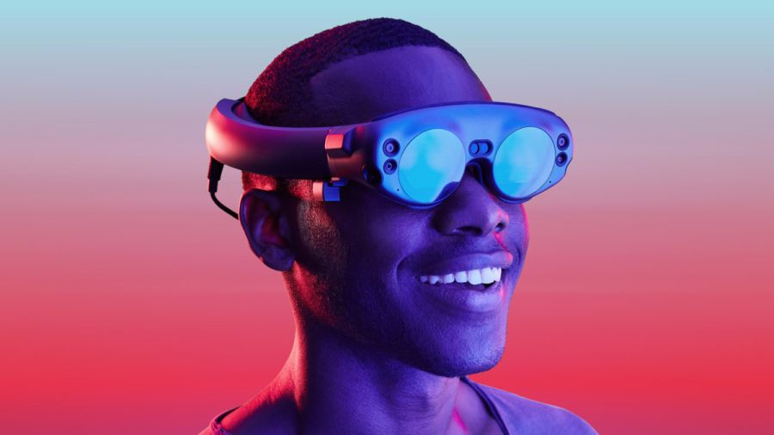
Future of AR
will
smart glasses
eventually replace
smart phones?

Slide 24
AR: Obstacles
Glasses look stupid
AR technology is socially awkward
Limited FoV
Limited sensing technology (image recognition)
No killer app

Slide 25


Slide 26
AR: Obstacles
Glasses look stupid
AR technology is socially awkward
Limited FoV
Limited sensing technology (image recognition)
No killer app

Slide 27
Interesting Applications of Augmented Reality
AR gives us superpowers

Slide 28
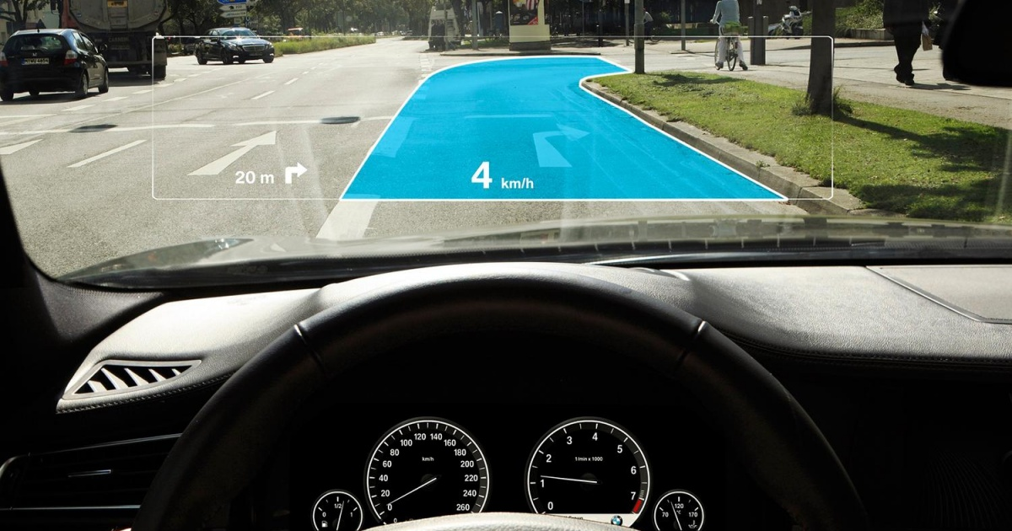
Augmented Reality transparent displays
Car windscreens coming in the near future
NASA & air forces already employ AR in planes

Slide 29
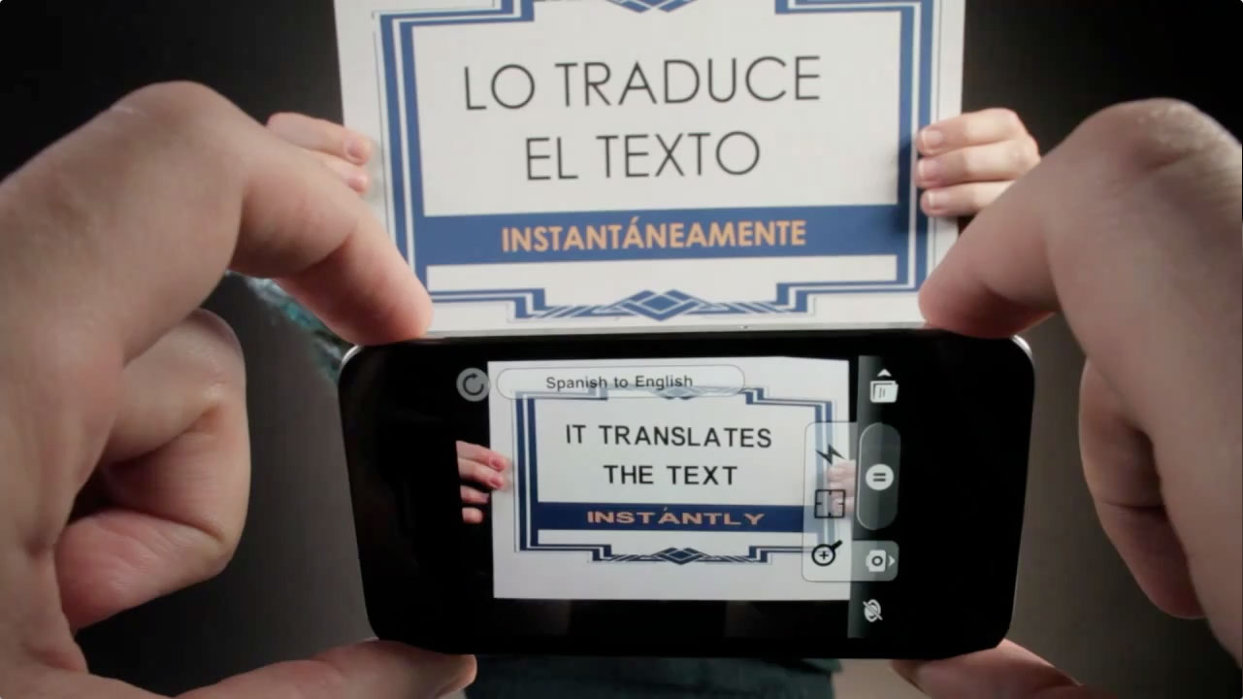
Real-time translation
Word Lens, released in 2010, used OCR to translate text through AR
Word Lens was bought by Google, and introduced into Google Translate in 2015

Slide 30

Real-time translation
Google can now translate spoken language in real time

Slide 31
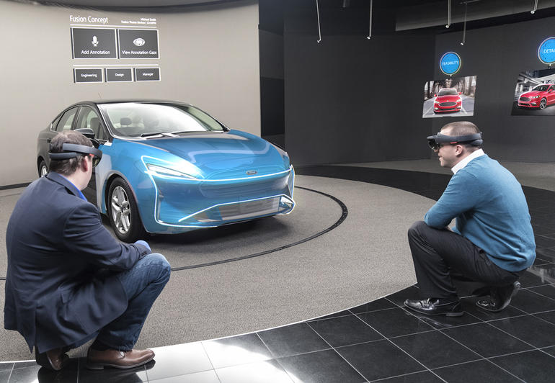
Augmented Reality design
Ford is test-driving HoloLens globally for faster car design
Multiple designers working together to modify their designs in realtime

Slide 32
Applications of AR (flipped classroom exercise)
Industry
Medicine
Military
Architecture
Elsewhere (non-gaming)?

Slide 33
Applications of AR (flipped classroom exercise)
Industry
Medicine
Military
Architecture
Elsewhere (non-gaming)?
5 Innovative Examples of Augmented Reality in Action (Adobe)

Slide 34
AR Design Principles

Slide 35
AR Design Principles
Define the Environment
Make onboarding simple
Keep it predictable
Leave clues
Make it useful
more guidelines at: https://developer.apple.com/design/human-interface-guidelines/ios/system-capabilities/augmented-reality/

Slide 36

Workshop Activity for Today AI: Augmented Induction
KU Induction as a gamified AR activity
Design an AR app (game) to encourage new students explore the Campus

